Slide 1
Personal Items Keepsakes
Basic 1 – Unit 3 b

Slide 2
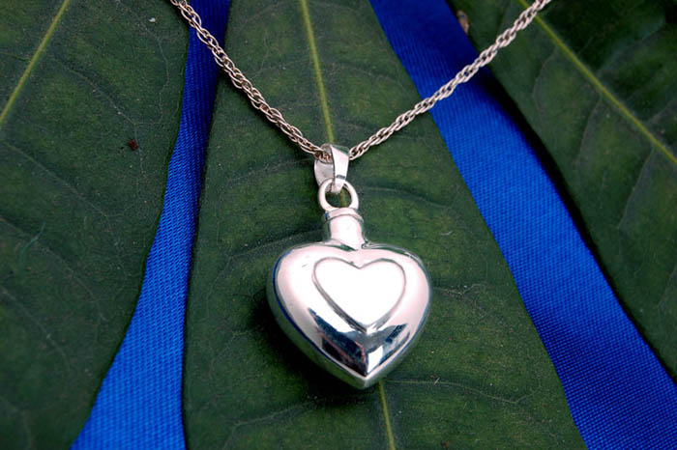
What is this?
It is a necklace. It is very important for my mom.

Slide 3
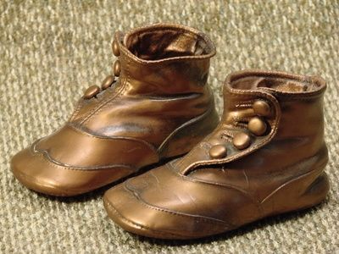
What is this?
They are baby´s shoes. They are very important for my mother.

Slide 4
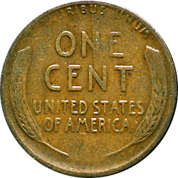

Slide 5
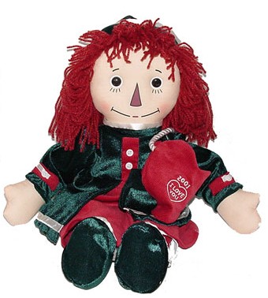
What is this?
It is a doll. It is very important for my sister.

Slide 6
My most important item is______because______
Yes, I do, my car. | No, I don´t.
A common first name for men in Peru is _____and for women is______
A popular song is ______

Slide 7
http://www.youtube.com/watch?v=jl5H8U6yh2Q
http://www.youtube.com/watch?v=h7N-4GUE2C0

